Slide 1
Transition-Based Neural Word Segmentation
Meishan Zhang, Yue Zhang, Guohong Fu
Heilongjiang University, Harbin, China
& SUTD

Slide 2
Chinese Word Segmentation
Chinese text is not delimited by spaces.
Word segmentation is a necessary precursor for language processing tasks.
Dictionary based rules not possible, segmentation depends on the context.
Sometimes, we are interested not only in the segmentation but also probability associated with that segmentation

Slide 3
Chinese Word Segmentation
Input (character sequence) :
南京市长江大桥
(nan jing shi chang jiang da qiao)
Output (word sequence)：
南京市 长江大桥
(Nanjing Yangtze River Bridge)

Slide 4
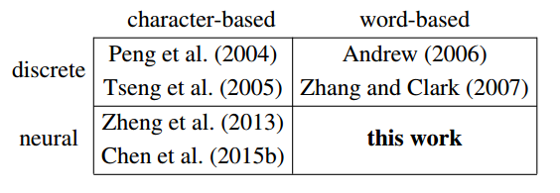
Previous works
Generate Candidate Segmentations
Rank them using perceptron, with manual features
Manual Features – word, word bigram, single character word, etc.
Baseline
CRF
Sequence labeling task – START/NONSTART
Manual Features: noun, adj, verb, adverb, prepos etc.
Sequence Label Task: One of four labels – B/I/E/S
Automatic feature extraction by using Neural Networks

Slide 5
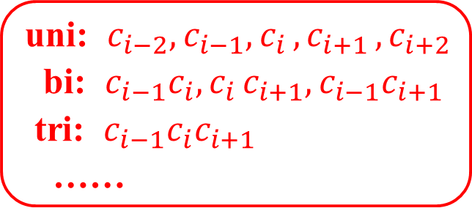

Typical Methods
Sequence Labeling:
$$c_{1}c_{2}⋯c_{i−2}c_{i−1}c_{i}c_{i+1}c_{i+2}⋯c_{n}$$
$$t_{1}t_{1}⋯t_{i−2}t_{i−1}t_{i}t_{i+1}t_{i+2}⋯t_{n}$$
CRF &
Discrete features:
uni: $c_{i−2}, c_{i−1}{,c}_{i}{,c}_{i+1}{,c}_{i+2}$
bi: $c_{i−1}c_{i}{,c}_{i}c_{i+1},c_{i−1}c_{i+1}$
tri: $c_{i−1}c_{i}c_{i+1}$
……

Slide 6
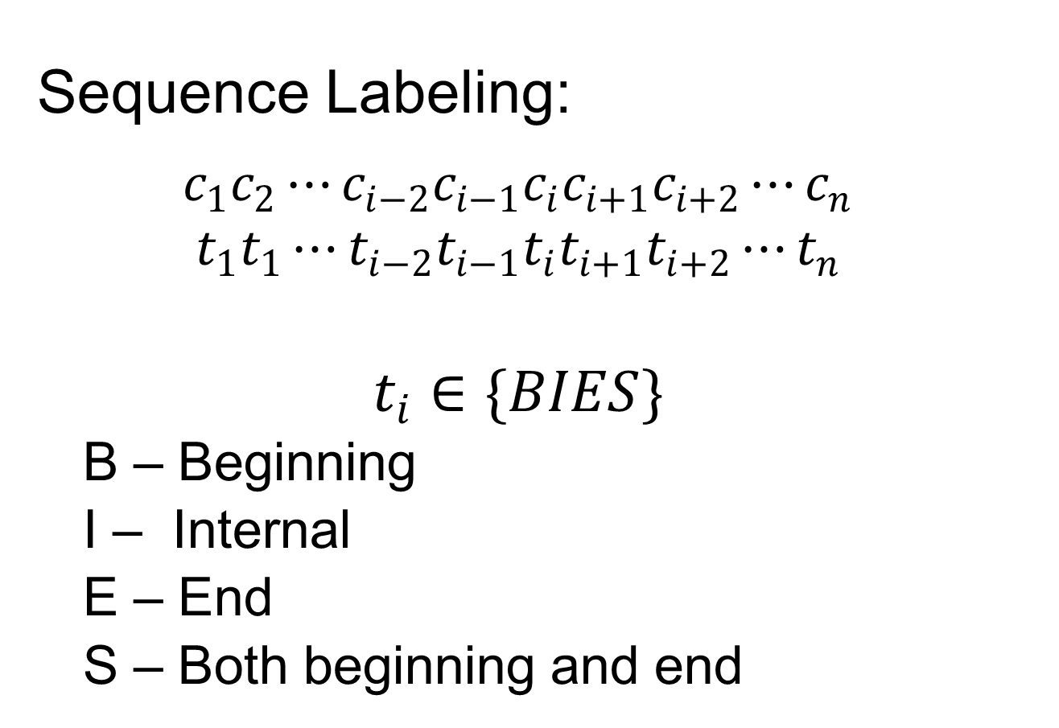
Typical Methods
Sequence Labeling:
$$c_{1}c_{2}⋯c_{i−2}c_{i−1}c_{i}c_{i+1}c_{i+2}⋯c_{n}$$
$$t_{1}t_{1}⋯t_{i−2}t_{i−1}t_{i}t_{i+1}t_{i+2}⋯t_{n}$$
$$t_{i}∈\{BIES\}$$
B – Beginning
I – Internal
E – End
S – Both beginning and end

Slide 7







Typical Methods
Sequence Labeling:
$$c_{1}c_{2}⋯c_{i−2}c_{i−1}c_{i}c_{i+1}c_{i+2}⋯c_{n}$$
$$t_{1}t_{1}⋯t_{i−2}t_{i−1}t_{i}t_{i+1}t_{i+2}⋯t_{n}$$
Neural Models:
+CRF
+LSTM……
char emb $⊕$
bichar emb
$${ c}_{i−2} { c}_{i−1}{ c}_{i}{ c}_{i+1}{ c}_{i+2}$$
$$e_{i}$$
$$h_{i}$$

Slide 8
Proposed Method
“Transition” – Incrementally builds the segmentation using partially segmented word(s).
Neural Networks to automatically extract features based on the partial segments obtained so far.
Uses one LSTM each to model word sequence, character sequence and action sequence.
Computes SEP and APP scores Beam search to find the best score for the current word.

Slide 9
Proposed Method
Transition-based (word-based):
长江大桥(chang jiang da qiao)
江大桥(jiang da qiao)
江大桥(jiang da qiao)
南京市
(Nanjing)
SEP
APP
南京市长
（Mayor of Nanjing）
南京市 长
(Nanjing) (chang)

Slide 10

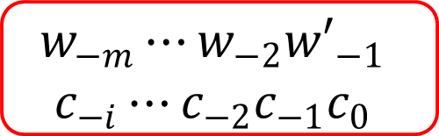

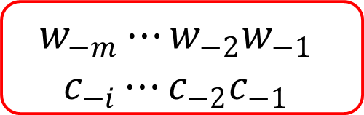


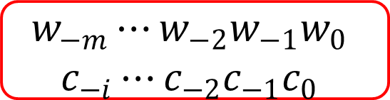
Proposed Method
Transition-based (word-based):
${w′}_{−1}$=$w_{−1}c_{0}$
$$w_{−m}⋯w_{−2}w_{−1}$$
$$c_{−i}⋯c_{−2}c_{−1}$$
$${ c}_{0}c_{1}⋯c_{n−i}$$
SEP
APP
$$w_{−m}⋯w_{−2}{w′}_{−1}$$
$$c_{−i}⋯c_{−2}{c_{−1}c}_{0}$$
$${ c}_{1}⋯c_{n−i}$$
$$w_{−m}⋯w_{−2}w_{−1}w_{0}$$
$$c_{−i}⋯c_{−2}{c_{−1}c}_{0}$$
$$c_{1}⋯c_{n−i}$$
Beam-Search + Max-Margin

Slide 11
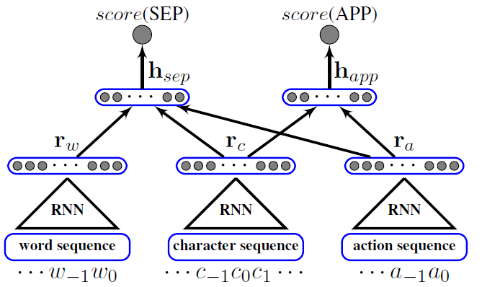
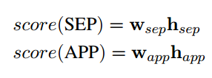
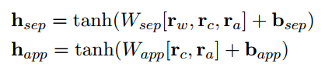
Proposed Neural Method

Slide 12
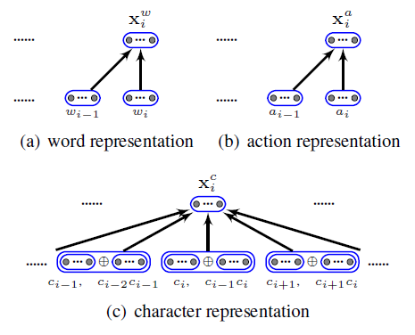
Proposed Neural method

Slide 13
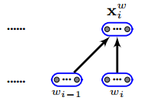
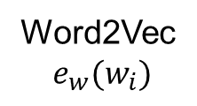
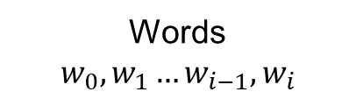

Input Representation
Words
$$w_{0}, w_{1}…w_{i−1}, w_{i}$$
Word2Vec
$$e_{w}(w_{i})$$
$$x_{i}^{w}=tanh⁡(W_{w}\left[e_{w}\left(w_{i−1}\right), e_{w}\left(w_{i}\right)\right]+b_{w})$$

Slide 14
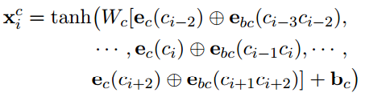
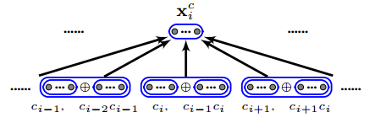
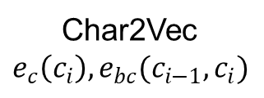
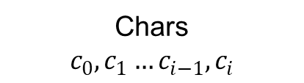
Input Representation
Chars
$$c_{0}, c_{1}…c_{i−1}, c_{i}$$
Bi-directional
Char2Vec
$$e_{c}\left(c_{i}\right), e_{bc}(c_{i−1}, c_{i})$$

Slide 15

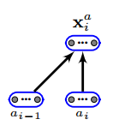
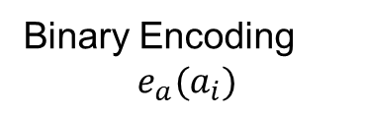
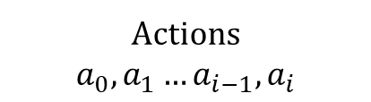
Input Representations
Actions
$$a_{0}, a_{1}…a_{i−1}, a_{i}$$
Binary Encoding
$$e_{a}(a_{i})$$

Slide 16
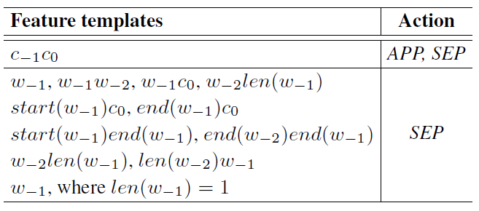
Baseline Discrete Features

Slide 17
Integrated Model
Add the score of discrete features here!!!

Slide 18
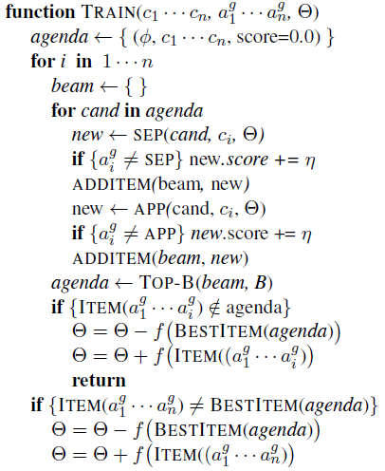
Max-Margin Training
Algorithm for Max-Margin
Θ is a set of all parameters
A_{k} model output sequence
λ is regularization parameter
η to tune the loss margin

Slide 19
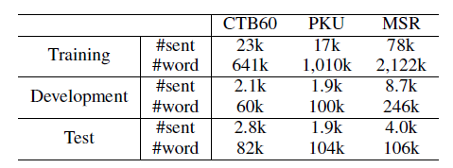
Experiments
Data set

Slide 20
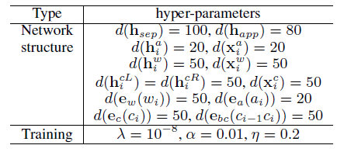
Experiments
Parameters (set empirically)

Slide 21
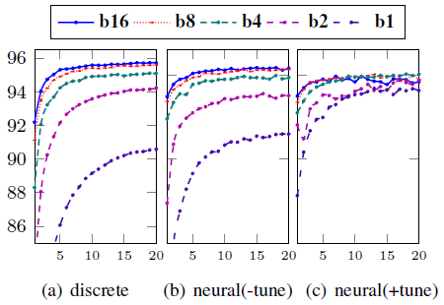
Experiment – Development Result
Accuracy against training epochs for different beam sizes

Slide 22
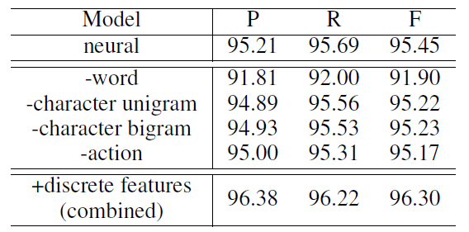
Experiments
Feature Ablation

Slide 23
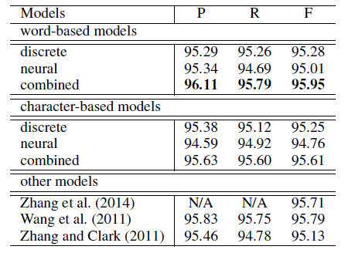
Experiments
Final Results on CTB60

Slide 24
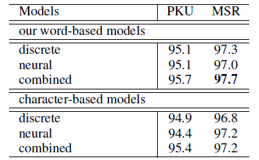
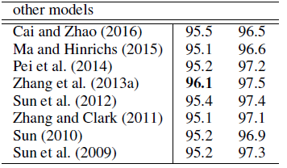
Experiments
Final Results

Slide 25
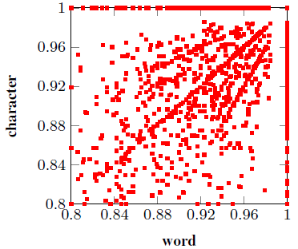
Comparison of Neural Models
Analysis on CTB60 (F measure) for character and word based neural models
Majority Scatter points are off the diagonal
Strong differences between the two neural models
It is because of the differences in feature scores

Slide 26
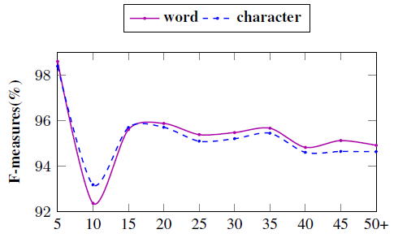
Comparison of Neural Models
Analysis F measure against character length

Slide 27
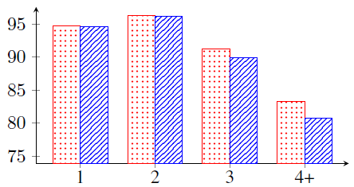
Comparison of Neural Models
F measure against word length
Red – Word Based Model
Blue – Character Based Model

Slide 28
Thank You

